Slide 1
Angular
Author: Giau Le

Slide 2
Agenda
Template reference variables
Component Interaction
Directives
Pipes
Routing & Navigation
Forms
Reactive forms
Template-driven forms

Slide 3
References
Roadmap
https://roadmap.sh/frontend
Prerequisite
https://www.w3schools.com/css/
https://www.w3schools.com/html/
https://www.typescriptlang.org/docs/handbook/typescript-in-5-minutes.html
Angular Docs
https://angular.dev
SCSS
https://sass-lang.com/guide/
UI Libs
https://getbootstrap.com/ or https://tailwindcss.com/docs/guides/angular
https://material.angular.io/ -> angular components
RxJs
https://rxjs.dev/
Project demo
https://github.com/helenhash/angular-demo/tree/feature/base-structure

Slide 4
Template reference variables
Get user input from a template reference variable
<input #box (keyup)="0"> <p>{{box.value}}</p>
https://angular.dev/guide/templates/reference-variables

Slide 5
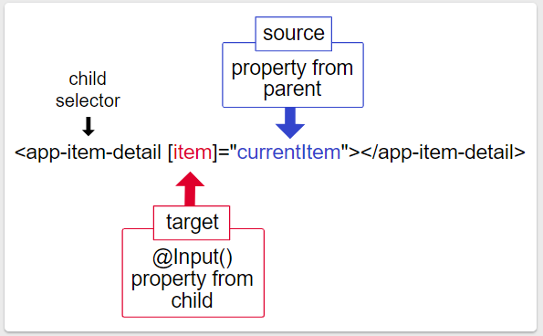
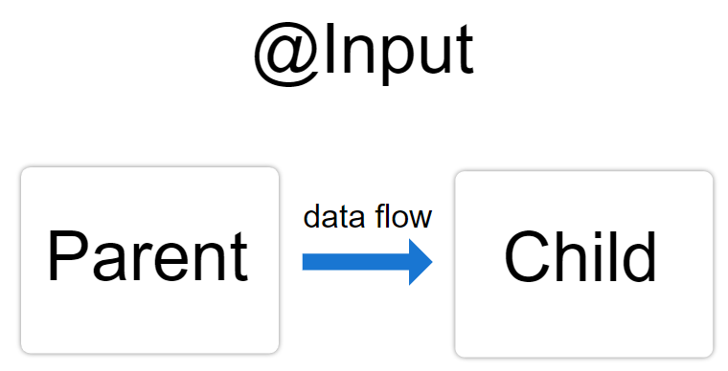
Component interaction
Data from parent to child with input binding
@Input decorations.
Intercept input property changes with a setter
@Input() set name(name: string) { this._name = (name && name.trim()) || '<no name set>'; }
Intercept input property changes with ngOnChanges()
ngOnChanges(changes: {[propKey: string]: SimpleChange})
https://angular.dev/guide/components/inputs

Slide 6
Component interaction
Parent listens for child event
https://angular.dev/guide/components/outputs
The child component exposes an EventEmitter property with which it emits events when something happens
The child's EventEmitter property is an output property
@Output() voted = new EventEmitter<boolean>();
Parent interacts with child via local variable
A parent component cannot use data binding to read child properties or invoke child methods.
Creating a template reference variable for the child element and then reference that variable within the parent template.
Parent calls an @ViewChild()
inject the child component into the parent as a ViewChild.
@ViewChild
Parent and children communicate via a service ...

Slide 7
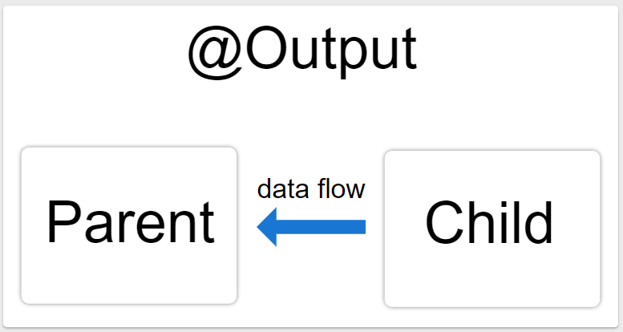
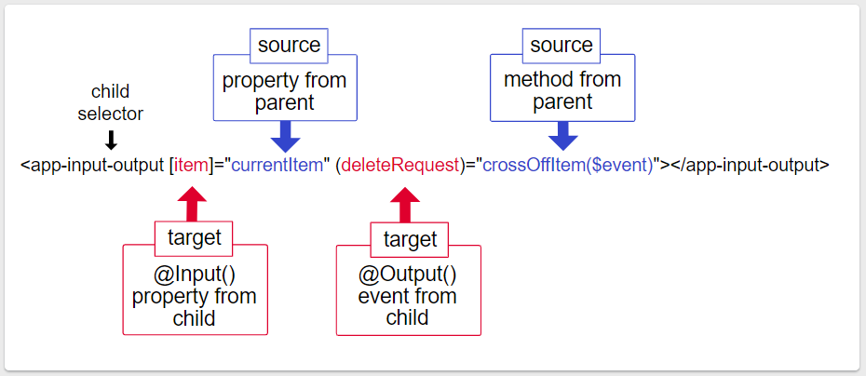
Component interaction
Input and Output properties
Syntax
@Input() hero: Hero;
@Output() deleteRequest = new EventEmitter<Hero>();
<hero-detail [hero]="currentHero" (deleteRequest)="deleteHero($event)"></hero-detail>

Slide 8
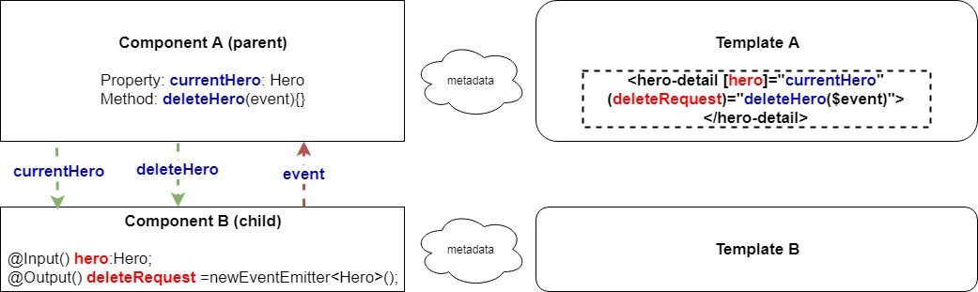
Component interaction
Input and Output properties example

Slide 9
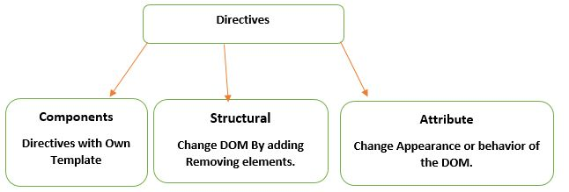
Directives

Slide 10
Directives
Built-in structural directives
NgSwitch
NgIf:
<app-hero-detail *ngIf="isActive"></app-hero-detail>
NgForOf:
<div *ngFor="let hero of heroes">{{hero.name}}</div>
Built-in attribute directives
NgClass—adds and removes a set of CSS classes.
NgStyle—adds and removes a set of HTML styles.
NgModel—adds two-way data binding to an HTML form element.

Slide 11
Attribute directives
Used as attributes of elements.
For example, can change several element styles at the same time.
An attribute directive minimally requires building a controller class annotated with @Directive, which specifies the selector that identifies the attribute.
Directives must be declared in Angular Modules in the same manner as components.
Angular CLI:
ng generate directive highlight
https://angular.dev/guide/directives/attribute-directives

Slide 12
Structural directives
Be Responsible for HTML layout.
They shape or reshape the DOM's structure, typically by adding, removing, or manipulating elements.
Three of the common, built-in structural directives—NgIf, NgFor, and NgSwitch.
Note: A directive could hide the unwanted paragraph instead by setting its display style to none.
https://angular.dev/guide/directives/structural-directives

Slide 13
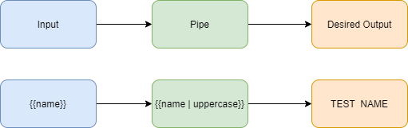
Pipes
A way to write display-value transformations that you can declare in your HTML
A pipe takes in data as input and transforms it to a desired output.

Slide 14
Pipes
Built-in pipes
DatePipe, UpperCasePipe, LowerCasePipe, CurrencyPipe, and PercentPipe
Ex: <p>The hero's birthday is {{ birthday | date:"MM/dd/yy" }} </p>
Chaining pipes
You can chain pipes together in potentially useful combinations.
{{ birthday | date | uppercase}}
Custom pipe
https://angular.dev/guide/pipes/transform-data

Slide 15
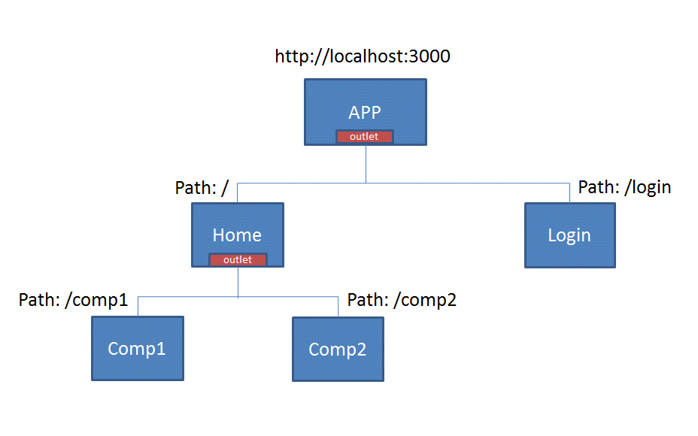
Routing & Navigation
https://angular.io/guide/router
You change what the user sees by showing or hiding portions of the display that correspond to particular components.

Slide 16
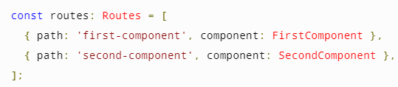
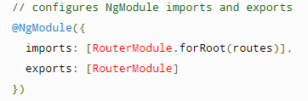
Routing & Navigation
Defining a basic route
Import RouterModule and Routes into your routing module.
Define your routes in your Routes array.
Add your routes to your application.
<a routerLink="/first-component" routerLinkActive="active">First Component</a>

Slide 17
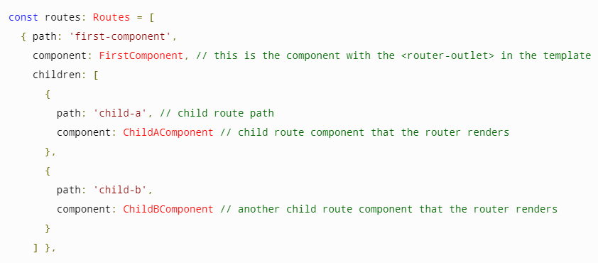
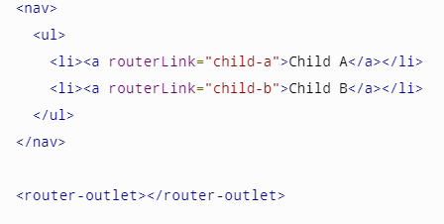
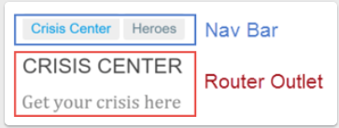
Routing & Navigation
Setting up wildcard routes
Ex: Displaying a 404 page
{ path: '**', component: PageNotFoundComponent }, // Wildcard route for a 404 page
Nesting routes
The router outlet serves as a placeholder where the routed components are rendered.

Slide 18
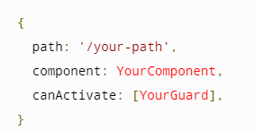
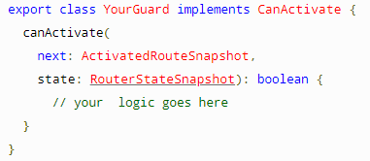
Routing & Navigation
Lazy loading
ng generate guard your-guard
Use route guards to prevent users from navigating to parts of an app without authorization. The following route guards
CanActivate
CanActivateChild
CanDeactivate
Resolve
CanLoad

Slide 19

Routing & Navigation
Router outlet
It acts as a placeholder that marks the spot in the template where the router should display the components for that outlet.

Slide 20
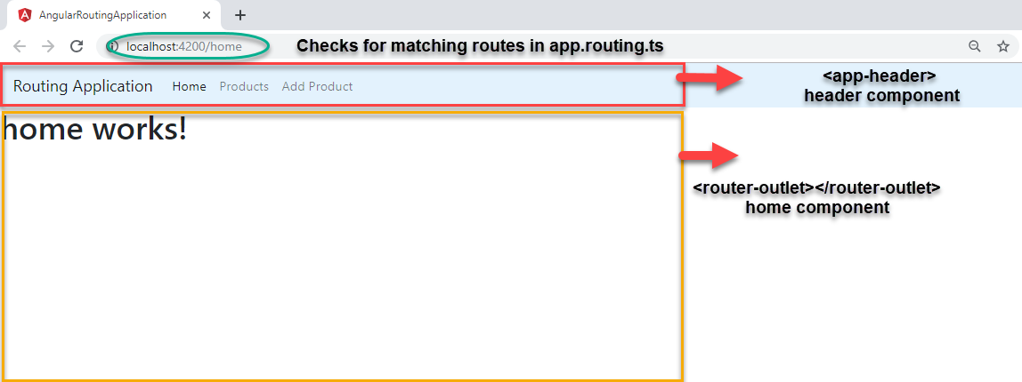
Routing & Navigation

Slide 21
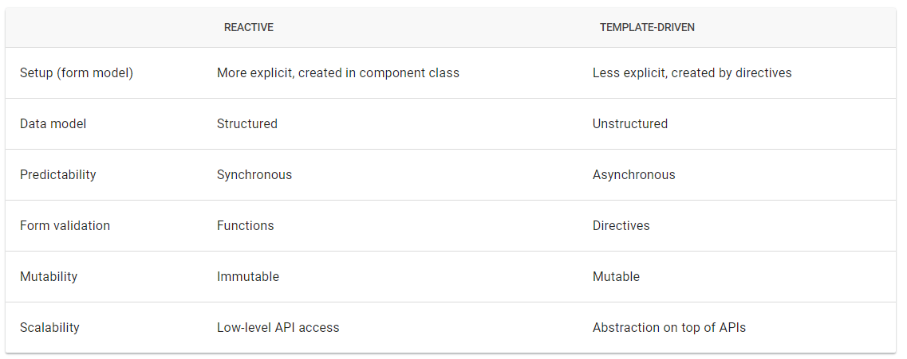
Forms
Angular provides two different approaches to handling user input through forms: reactive and template-driven.

Slide 22
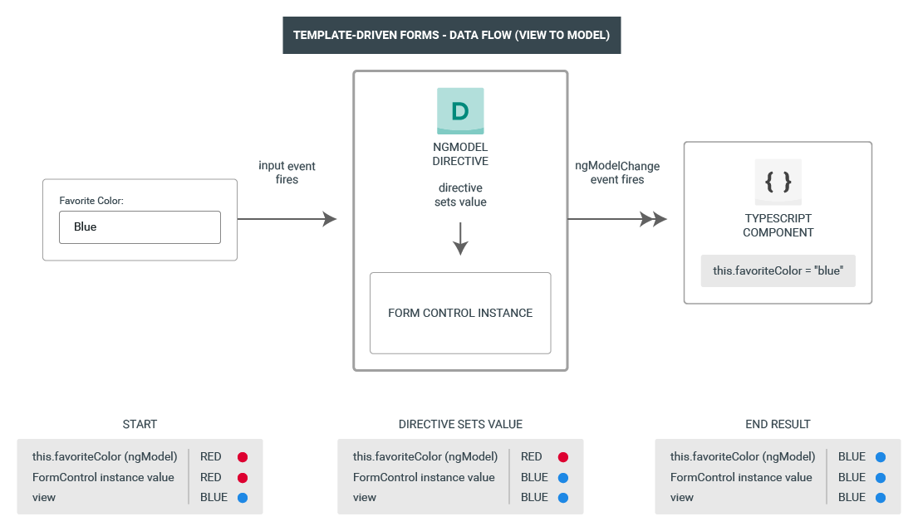
Template-driven forms
Template-driven forms use two-way data binding to update the data model in the component as changes are made in the template and vice versa.

Slide 23
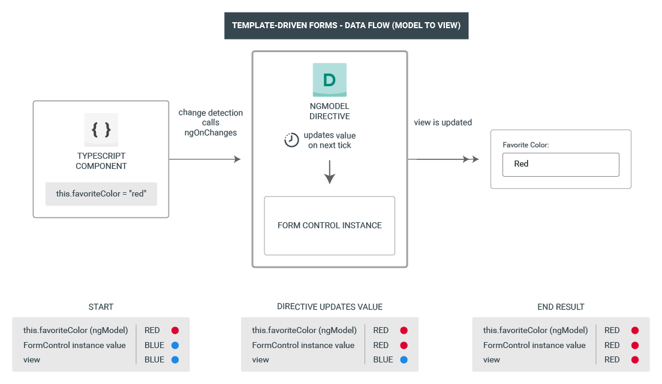
Template-driven forms

Slide 24
Template-driven forms
Build the basic form.
Define a sample data model.
Include FormsModule.
Bind form controls to data properties using the ngModel directive and two-way data-binding syntax.
Examine how ngModel reports control states using CSS classes.
Name controls to make them accessible to ngModel.
Validity and control status using ngModel.
Track input Add custom CSS to provide visual feedback on the status.
Show and hide validation-error messages.

Slide 25
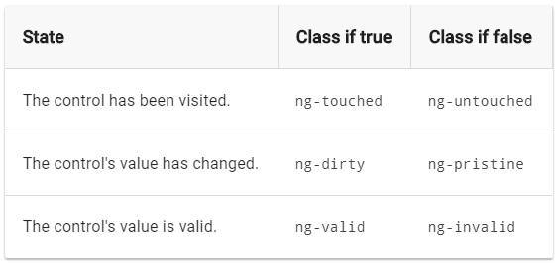
Template-driven forms
import { FormsModule } from '@angular/forms';
Two-way data binding with ngModel
<input type="text" class="form-control" id="name" required [(ngModel)]="model.name" name="name">
Track control state and validity with ngModel

Slide 26
Template-driven forms
Show and hide validation error messages
<div [hidden]="name.valid || name.pristine" class="alert alert-danger"> Name is required </div>
Submit the form with ngSubmit
<form (ngSubmit)="onSubmit()" #heroForm="ngForm">
<button type="submit" class="btn btn-success" [disabled]="!heroForm.form.valid">Submit</button>

Slide 27
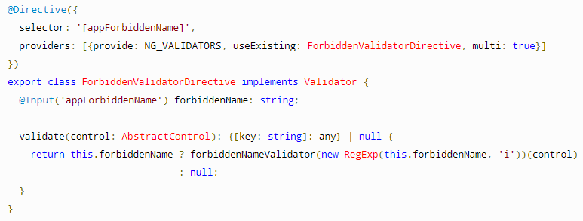
Template-driven forms
Validating form input
Built-in validator directives
<input id="name" name="name" class="form-control" required minlength="4" [(ngModel)]="hero.name" #name="ngModel" >
Custom validators
Defining custom validators
Adding custom validators
<input id="name" name="name" class="form-control" appForbiddenName="bob" [(ngModel)]="hero.name" #name="ngModel" >Display form status
Form Status: {{ profileForm.status }}

Slide 28
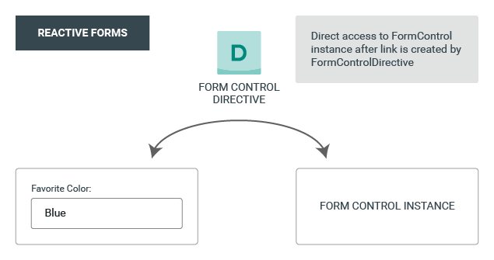
Reactive form
Model-driven approach to handling form inputs

Slide 29

Reactive form
Three steps to using form controls
Register the reactive forms module in your app. - ReactiveFormsModule
Generate a new FormControl instance and save it in the component.
Register the FormControl in the template.
Displaying a form control value
Through the valueChanges observable where you can listen for changes in the form's value in the template.
With the value property, which gives you a snapshot of the current value.

Slide 30
Reactive form
Grouping form controls
A form group defines a form with a fixed set of controls that you can manage together.
A form array defines a dynamic form, where you can add and remove controls at run time.
Steps
Create a FormGroup instance.
Associate the FormGroup model and view.
Save the form data.

Slide 31
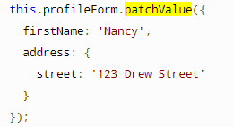
Reactive form
Updating parts of the data model
Use the setValue() method to set a new value for an individual control.
this.name.setValue('Nancy');
Use the patchValue() method to replace any properties defined in the object that have changed in the form model.
Using the FormBuilder service to generate controls
Import the FormBuilder class.
Inject the FormBuilder service.
Generate the form contents.

Slide 32
Reactive form
Validating input in reactive forms
Sync validators: Synchronous functions that take a control instance and immediately return either a set of validation errors or null. You can pass these in as the second argument when you instantiate a FormControl.
Async validators: Asynchronous functions that take a control instance and return a Promise or Observable that later emits a set of validation errors or null. You can pass these in as the third argument when you instantiate a FormControl.
isUserNameDuplicated(control: AbstractControl): Observable<ValidationErrors> { return of(null); }
let control = new FormControl("", Validators.required, this.isUserNameDuplicated);
this.fb.control("", Validators.required, this.isUserNameDuplicated);

Slide 33
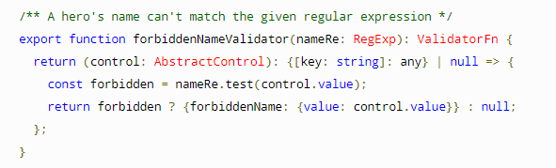
Reactive form
Validating form input
Built-in validator functions
Custom validators
Defining custom validators
Adding custom validators
name: new FormControl(
this.hero.name, [forbiddenNameValidator(/bob/i)])
Form Status:
{{ profileForm.status }}
let control = new FormControl("", Validators.required);
//Or this.fb.control("", Validators.required);

Slide 34
Assignment
Build a base project structure
Demo with “Parent listens for child event”
Build main component include: header, footer, menu, router outlet ...
Build UI pages for product manangement (ref mid-term)
List product: id, name, price, status,.... Search by name, sort by name or price (pagination)
Add new product (reactive form)
Edit product
Activate / deactivate product (toggle each row and in product detail page)
Note
Focus on design UI, pages, understand angular project and flow
Need not to integrate with api in this week
For list of products page, you can user AG-Grid lib for angular (this is just suggestion)
https://www.ag-grid.com/angular-data-grid/getting-started/

